Slide 1

Tina Krznarić
Mogućnosti zapošljavanja i stažiranja u institucijama EU
Pula, svibanj 2015.
Notes:
Your commitment. Our 28 countries.
Your career. Our European Union.
Looking for a challenging career in a dynamic environment? Based in the heart of Europe, the EU Institutions offer you a truly international career. Serving over 500 million citizens, a range of options are available, all with the chance to make a real and lasting difference.
Your passion for Europe. Our vision for Europe.
Working for the EU Institutions means working for a better future. Since its foundation, the EU has achieved peace and stability for its Member States and changed the way we live, work and travel. With its Institutions and agencies, the EU has evolved into an organisation spanning a very broad range of policy areas, from development aid to environmental policy, from fighting organised crime to ensuring the rights of minorities, from promoting research and innovation to supporting regional development.
Given the exceptional scope and remit of European policy and legislation, an EU career offers variety, mobility and the opportunity to continue to grow professionally, intellectually and personally throughout your professional life.
Your career. Our context.
An EU career offers a unique opportunity to work in any of ten EU institutions and agencies including the European Parliament, Commission, Council, External Action Service, Court of Justice or Court Auditors. We also have offices in over 130 locations worldwide, with opportunities to travel offered in many of our roles.
Most of the EU institutions are located in Brussels or Luxembourg. With many other international companies and organisations nearby, you can expect to meet people from all over the world and find many products and services tailored to the needs of international professionals, including national, European and international schools.
The EU institutions support diversity and equal treatment in a tolerant and respectful working environment.
Your plans. Our possibilities
Flexibility is key for the EU institutions, so we encourage mobility and offer talented employees a lifetime of different opportunities working in varied projects, roles and teams. We encourage you to plan your career pro-actively, defining your own interests and taking important decisions regarding your future career path.
For final-year students and graduates, the EU offers entry-level positions for generalists and translators, which are the starting point to an exciting and truly international career.
For professionals with experience , there are positions in various specialist fields, ranging from administrative assistants to economists, lawyers, translators, IT experts and other specialists.
Find out more on jobs.eu-careers.eu for our latest job opportunities.
We are always looking for people who are ready to face a bigger challenge.

Slide 2
Što je EPSO?
European Personnel Selection Office (Europski ured za odabir osoblja)
Zaduženi za selekcijske procese za institucije EU

Slide 3










Gdje vas EU karijera može odvesti ?
Vijeće EU
Odbor regija
Europska komisija
Europski gospodarski i socijalni odbor
Europski
parlament
Europska služba za vanjsko djelovanje
Europski
ombudsman
Sud Europske
unije
Europski
revizorski sud
Europski nadzornik za zaštitu podataka

Slide 4



Gdje vas EU karijera može odvesti?
Bruxelles
Luxembourg
20% drugdje u EU i svijetu

Slide 5



Zašto karijera u EU?
Učinite nešto korisno za Europu
Razvoj karijere i osobni rast
Međunarodno radno okruženje
Notes:
What we have to offer to you as an employer:
Make a difference + interesting and challenging work
L+D: training, languages, job mobility, flexible working, benefits
International working env: Bru/Lux, travel, mobility

Slide 6
Profili za osobe s fakultetskim obrazovanjem
Opći profili
Revizori
Prevoditelji
Pravnici-lingvisti
Notes:
EU Careers has many different profiles to offer.
However for many profiles experience is required.
There are 4 types of profiles for which you can apply, where no experience is required.
Generalists
Auditors
Translators - languages vary every year
Lawyer-linguists – languages vary every year. This profile requires knowledge of 3 languages + a law diploma.
Mentioning different profiles & fields ➔ here only Generalists + AUDIT is included. – Not going into detail on AST non graduate positions

Slide 7
Kada se prijaviti?
Proljeće
Proljeće
Opći profili
Revizori
Ljeto
Proljeće
+
jesen
Prevoditelji
Pravnici- lingvisti
Notes:
Lawyer-linguists:
Spring = Court of Justice ➔ French required
Autumn = Council & EP
Same name, different duties – for more information – not included in this presentation.

Slide 8
Opći profili (administratori)
Notes:
EU Careers has many different profiles to offer.
However for many profiles experience is required.
Generalist is one of the 4 types of profiles for which you can apply, where no experience is required.
The general role of administrators is to support decision-makers in fulfilling the mission of their institution or body.
AD 5 is the grade at which most graduates and young professionals begin their careers as administrators in the European institutions.
If you are recruited at this grade following this competition, you will do, as part of a team, 3 main types of work in the EU institutions:
policy formulation,
operational delivery,
resource management.

Slide 9
Tražimo prvostupnike ili magistre struke za poziciju administratora u
- oblikovanju politike
- izvršavanju komunikacijskih i organizacijskih zadataka
- menedžmentu resursa za institucije u Bruxellesu i Luxembourgu
Administratori
149

Slide 10
Tražimo li baš tebe?
Administratori
Građanin Europske unije
Završen sveučilišni studij u trajanju od najmanje 3 godine
Govorite engleski, njemački ili francuski, te najmanje još 1 služebni jezik Europske unije
Notes:
completed university studies of at least three years attested by a diploma.
Students in their final year at university may take part in the competition provided that their diploma is awarded by 31 July 2015 at the latest
Basic eligibility criteria are:
EU citizenship
2 EU languages (2nd = EN, FR or DE)
Graduate profiles (Administrator): bachelor (at least)
Non-graduate profiles (Assistant): secondary education + 6 yrs of prof. exp. / post-secondary education + 3 yrs of prof. exp.
No professional experience required.

Slide 11




Pregled selekcijskog postupka
Administratori
Testovi samoprocjene prije prijave
Predselekcijski test
Međutest
Centar za procjenu
Lista uspješnih kandidata
Notes:
This is a simplified diagram of the structure of a competition, which does not reflect all possible variations for different types of competitions.
Online registration – by taking self-selection and self assessment tests + filling out the application form -→ reserve some time to do this (these tests can take up to 2 hours, for the application form you need additional time)
You will be asked to book a CBT test appointment later on - (via EU Careers website and EPSO Account)
Sitting pre-selection tests - computer-based admission tests (may not apply for specialist competitions) – details of types of tests on later slides.
The candidates who achieve the best marks in the pre-selection tests are invited to attend the intermediairy test in a test centre in Europe.
The candidates who achieve the best marks in the intermediary tests are invited to attend an assessment centre in Brussels – details on later slides.
The candidates who achieve the highest aggregate marks at the assessment centre will be included on a reserve list (subject to proof that they meet all the eligibility requirements) and are then available for recruitment by an institutiton).
Entry by open competition: Notice of Competition published in Official Journal of European Union, also available via www.eu-careers.eu
Single point of entry: European Personnel Selection Office (EPSO) - Apply online at: www.eu-careers.eu
Organised in annual cycles for general profiles
The European institutions select future officials through open competitions, which involve a series of competitive examinations.
Competitions are open to all citizens of the European Union who meet the specified requirements. This procedure gives all candidates a fair chance to demonstrate their abilities and guarantees selection based on merit while observing the principle of equal treatment.
A Notice of Competition (24 languages) setting out the requirements for each competition is published in the Official Journal of the European Union and can be accessed via the EU Careers website. Online registration to competitions is via the same website (in English, French or German).
A selection board is appointed to select the best candidates in the light of the requirements set out in the competition notice. The board compares the candidates’ performance in order to assess their suitability for the duties described in the notice. Its task is not only to evaluate their knowledge but also to identify those who are best qualified in terms of merit.
Competitions are organised:
- either in annual cycles;
- or to meet specific needs of the institutions.
More on the annual cycles of competitions on a later slide.
Candidates who pass a competition are placed on a reserve list from which the institutions draw recruits as and when they need them. The aim of a competition, then, is not to fill a specific post, but to constitute a reserve pool for recruitment.
The European Personnel Selection Office (EPSO) is the interinstitutional office responsible for organising competitions .
Two-stage procedure:
Selection
Recruitment
EPSO is responsible for the selection procedure.
The Institutions are responsible for recruitment.
For the process, procedures and scoring of all tests, you can find all details per test in the Notice of Competition.

Slide 12

Predselekcijski testovi
Računalni testovi višestrukog izbora
Administratori
Kada ste pozvani?
Predselekcijski testovi
Ako potvrdite svoj prijavni obrazac unutar roka.
Verbalno zaključivanje*
Numeričko zaključivanje*
Apstraktno zaključivanje*
Situacijska procjena na jeziku 2 (EN/FR/DE)
Vaši rezultati
Za verblano i numeričko zaključivanje postoji minimalan broj bodova koji mora biti zadovoljen.
Rezulteti se neće uzimati u obzir za Vaš ukupan rezultat na predselekcijskim testovima.
*Testovi na 1. jeziku
(1 od 24 službena EU jezika)
Notes:
Part of each selection procedure are reasoning tests. The reasoning tests test your general cognitive abilities.
You will receive the « Pre-selection - Computer based testing » brochure which explains what you can expect during this day.
Results of verbal and numerical reasoning test will not be taken into account of your pre-selection mark.
You must reach the minimum pass mark.
Your scores for Abstract reasoning+ Situational judgment are essential to make it to the second stage of the procedure.

Slide 13
Među testovi (Intermediary test)
E-tray vježba na 2. jeziku (EN/FR/NJEM)
Testni centar u Europi
Kada ste pozvani?
E-tray vježba
Ako prođete sve predselekcijske testove
+
Imate jedan od najviših rezultata u: apstraktnom zaključivanju
i testu situacijske procjene
15 do 20 pitanja
Procjenjuje se:
Analiziranje i rješavanje problema
Kvaliteta i rezultati
Odabir prioriteta i organiziranost
Rad s drugima
U ovu fazu testiranja bit će pozvano otprilike 10 puta više kandidata od traženog broja zaposlenika.
Test na 2. jeziku (engleski, njemački, francuski)
Notes:
When invited, you will receive information which explains what you can expect in this test.

Slide 14

Centar za procjenu na 2. jeziku
Testni centar u Bruxellesu
Administratori
Kada ste pozvani?
Assesment centre
Ako ste ostvarili jedan od najviših ukupnih rezultata na e-tray zadatku
+
Udovoljavate zahtjevima prihvatljivosti prema podacima u Vašoj prijavi
Studija slučaja
Grupna vježba
Strukturirani intervju
Usmena prezentacija
U ovu fazu bit će pozvano otprilike 2 puta više kandidata od traženog broja zaposlenika.
Testovi na 2. jeziku
(engleski, francuski ili njemački)
Notes:
When invited, You will receive the « Assessment Centre » brochure which explains what you can expect during this day in Brussels.
The Assessment centre which tests the following:
Specific competencies
General competencies

Slide 15
Centar za procjenu
Testira 8 kompetencija
Administratori
Analiziranje i rješavanje problema
Otpornost
Potencijal za vođenje
Određivanje prioriteta i organiziranost
Komunikacija
Učenje i razvoj
Kvaliteta i rezultati
Rad s drugima
Notes:
For a full overview on these competencies and how they are tested, see the Guide to Open Competitions and the notice of competition for the competition you apply for.
It will be published on our website.

Slide 16





Administratori
Regrutacija
Lista uspješnih kandidata
Slobodno mjesto
Intervju
Ponuda posla
Notes:
This is a simplified overview of a recruitment process, which does not reflect all possible variations for different types of competitions.
Your are listed in the database of successful candidates – reserve list
Institutions with a vacancy contact suitable candidates on the reserve list for an interview
If there is a match you will be provided with a job offer.
Candidates who pass a competition are placed on a reserve list from which the institutions draw recruits as and when they need them. The aim of a competition, then, is not to fill a specific post, but to constitute a reserve pool for recruitment.
The European Personnel Selection Office (EPSO) is the interinstitutional office responsible for organising competitions .
Two-stage procedure:
Selection
Recruitment
EPSO is responsible for the selection procedure.
The Institutions are responsible for recruitment.

Slide 17
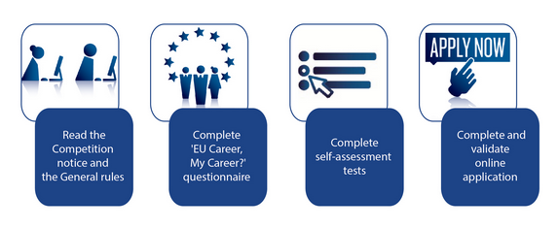
Kako se prijaviti?
Generalist competition
Graduates.eu-careers.eu
Prijave od 19. ožujka do 21. travnja 2015.
Notes:
For all types of tests you can find examples on our website, these are intended to give you an idea about what you can expect.
Before you apply for the AD5 generalist or the Auditors competition – you will have to take a series of tests.
A self-selection test' EU Career, My Careers' to give you an idea about working for the EU institutions.
A set of self-assessment tests – that reflect the level and type of tests that you can expect in the pre-selection phase.
This all explained in detail on the website. Your results of tests have no impact on your further application.
But take into account that this will involve some time, before you can access the application form.
Don't wait until the last moment before your start your application!
Also have a look at our sample test pages – where you can find mock exercises and a video on what a GENERAL day in the assessment centre looks like.
Reasoning tests are available in a timed environment

Slide 18
Paket prednosti
Plaća AD5: 4384 €/mjesečno
Edukacije: - jezici
-vještine
Poslovna putovanja
Radna pokretljivost
Ravnoteža rad-posao
- zdravstveno
- briga o djeci
- europske škole
Notes:
AD5 4384 €
AST1 2675 €
AST/SC1 2345 €

Slide 19
Revizori
Notes:
From March 26 – April 28 there is also the Auditors competition for the Court of Auditors in Luxembourg.
A brief overview of what we are looking for…
The auditors of the EU institutions are in charge of financial, performance and internal audits. They also provide assurance and advisory services in all operational fields of the EU and as such can operate in various countries or international organisations.
The nature of the duties requires a wide range of knowledge in fields such as law, accountancy, public administration, finance and economics, project management in the EU’s various areas of competence, IT, audit and assessment techniques.

Slide 20

Tražimo prvostupnika ili magistara struke za poziciju revizora u financijama, izvedbi i internim revizijama za rad u Revizorskom sudu u Luksemburgu
Revizori
80
Notes:
The auditors of the EU institutions are in charge of financial, performance and internal audits. They also provide assurance and advisory services in all operational fields of the EU and as such can operate in various countries or international organisations.
The nature of the duties requires a wide range of knowledge in fields such as law, accountancy, public administration, finance and economics, project management in the EU’s various areas of competence, IT, audit and assessment techniques.

Slide 21
Tražimo li baš tebe?
Revizori
Građanin Europske unije
Završen sveučilišni studij u trajanju od najmanje 3 godine
Govorite engleski, njemački ili francuski, te najmanje još 1 služebni jezik Europske unije
Notes:
completed university studies of at least three years attested by a diploma.
Students in their final year at university may take part in the competition provided that their diploma is awarded by 31 July 2015 at the latest
Basic eligibility criteria are:
EU citizenship
2 EU languages (2nd = EN, FR or DE)
Graduate profiles (Administrator): bachelor (at least)
Non-graduate profiles (Assistant): secondary education + 6 yrs of prof. exp. / post-secondary education + 3 yrs of prof. exp.
No professional experience required.

Slide 22
Tražimo li baš tebe?
Revizori
Završen najmanje trogodišnji studij
Radni zadaci za ovaj profil zahtijevaju širok raspon znanja iz područja kao što su:
pravo
računovodstvo
javna administracija
financije i ekonomija
project management
u raznim područjima djelovanja EU, IT, revizija i tehnike procjene.
Notes:
completed university studies of at least three years attested by a diploma.
Students in their final year at university may take part in the competition provided that their diploma is awarded by 31 July 2015 at the latest
Basic eligibility criteria are:
EU citizenship
Graduate profiles (Administrator): bachelor (at least)
Duties are listed in the Notice of Competition → knowledge related to the duties is essential!
Procedure as shown in the AD5 generalists overview.

Slide 23
Kako se prijaviti?
Revizori
Auditors.eu-careers.eu
Prijave od 26. ožujka do 28. travnja 2015.
Notes:
For all types of tests you can find examples on our website, these are intended to give you an idea about what you can expect.
Before you apply for the AD5 generalist or the Auditors competition – you will have to take a series of tests.
A self-selection test' EU Career, My Careers' to give you an idea about working for the EU institutions.
A set of self-assessment tests – that reflect the level and type of tests that you can expect in the pre-selection phase.
This all explained in detail on the website. Your results of tests have no impact on your further application.
But take into account that this will involve some time, before you can access the application form.
Don't wait until the last moment before your start your application!
Also have a look at our sample test pages – where you can find mock exercises and a video on what a GENERAL day in the assessment centre looks like.
Reasoning tests are available in a timed environment

Slide 24

Kako se pripremiti?
Primjeri testova
Notes:
An overview of what type of tests you can expect + some samples.

Slide 25
Kako se pripremiti?
Posjetite stranicu sample-tests.eu-careers.eu
Prijava
Predselekcijski testovi
Centar za procjenu
Prijavite se na vrijeme!
Ne čekajte posljednji trenutak.
Predselekcijski testovi
Vježba
+
video
Notes:
For all types of tests you can find examples on our website, these are intended to give you an idea about what you can expect.
Reasoning tests are available in a timed environment
There are mock exercises and a video on what a GENERAL day in the assessment centre looks like.

Slide 26
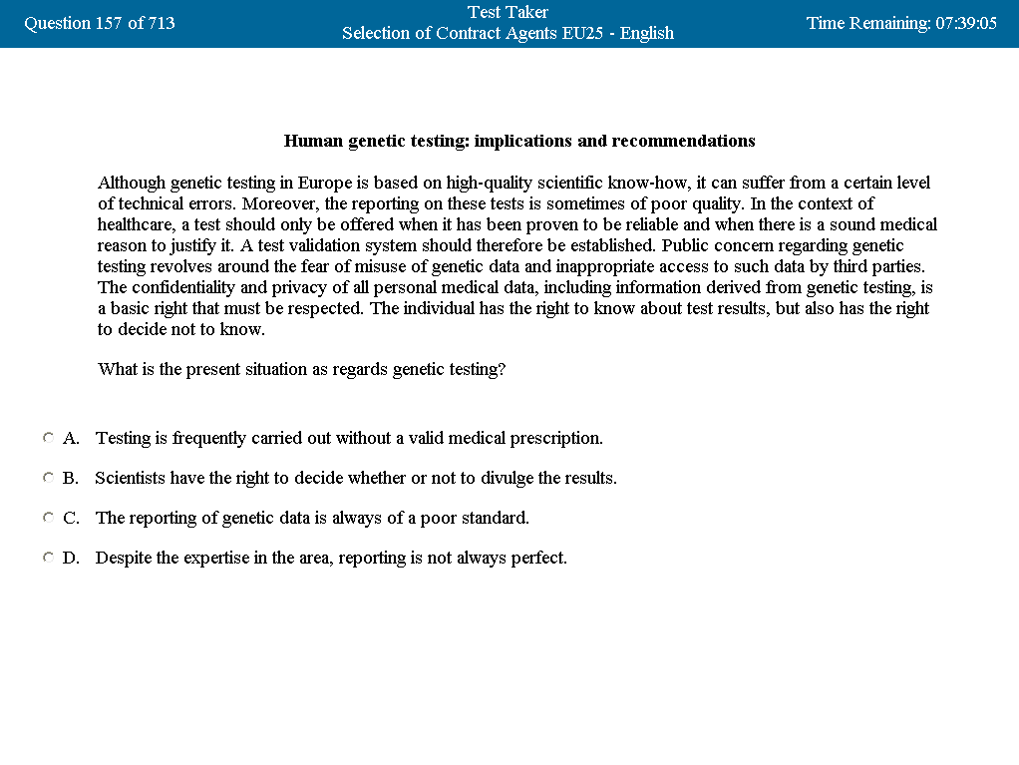
Primjer verbalnog zaključivanja

Slide 27
Primjer verbalnog zaključivanja

Slide 28
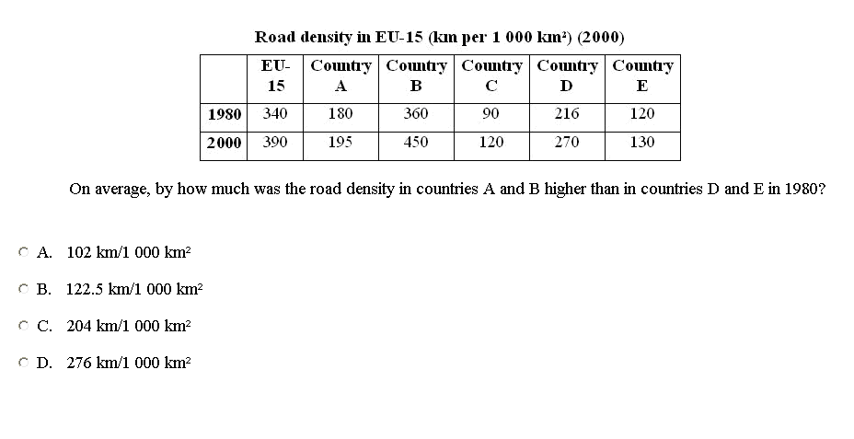
Primjer numeričkog zaključivanja

Slide 29
Primjer numeričkog zaključivanja

Slide 30
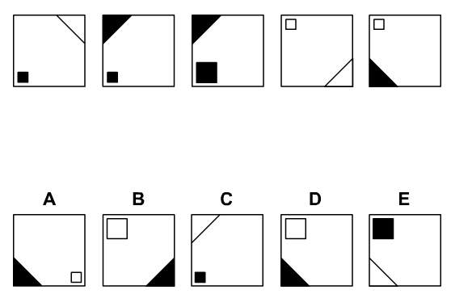
Primjer apstraktnog zaključivanja

Slide 31
Primjer apstraktnog zaključivanja

Slide 32
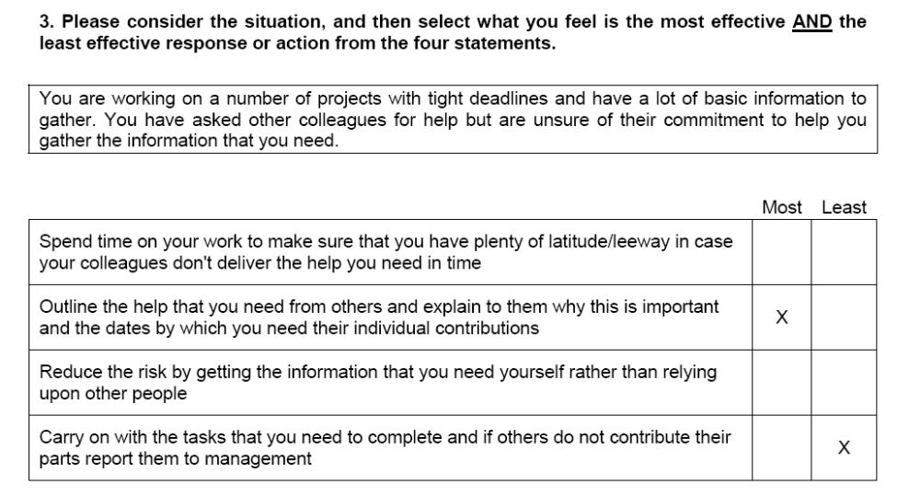
Primjer situacijske procjene
X
X

Slide 33
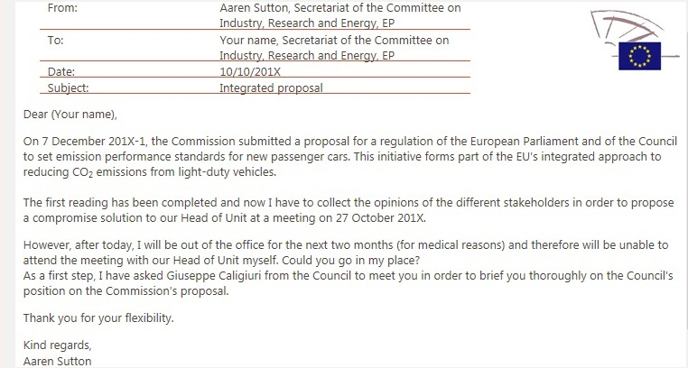
Primjer e-tray zadatka
Notes:
The e-tray exercise tests:
Analysing & problem-solving
Delivering quality & results
Prioritising & organising
Working with others
You will take this test on computer in your second language (English, French or German) and will have to answer a number of questions.
The documentation you will need is contained in a mailbox where you will find the relevant background information.
You will have to choose your answers by clicking on a box with the mouse.
You may change your chosen answer at any time by clicking on another box.
You will have 50 minutes in total to read through the e-mails and complete the questionnaire.
Before you start the test, you will be given time to read the instructions.

Slide 34
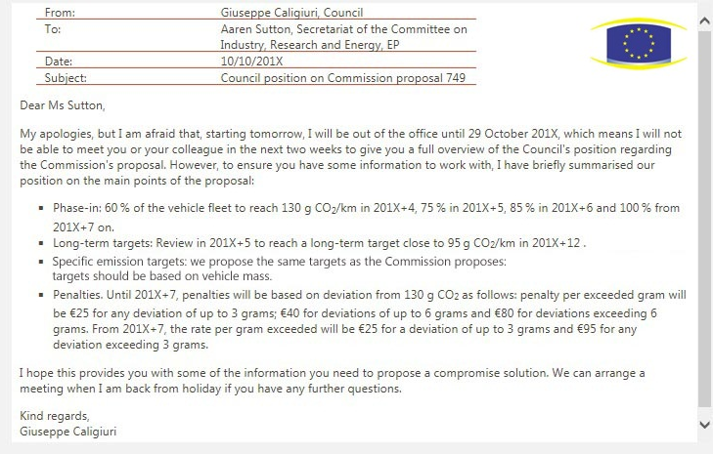
Primjer e-tray zadatka
Notes:
The e-tray exercise tests:
Analysing & problem-solving
Delivering quality & results
Prioritising & organising
Working with others
You will take this test on computer in your second language (English, French or German) and will have to answer a number of questions.
The documentation you will need is contained in a mailbox where you will find the relevant background information.
You will have to choose your answers by clicking on a box with the mouse.
You may change your chosen answer at any time by clicking on another box.
You will have 50 minutes in total to read through the e-mails and complete the questionnaire.
Before you start the test, you will be given time to read the instructions.

Slide 35
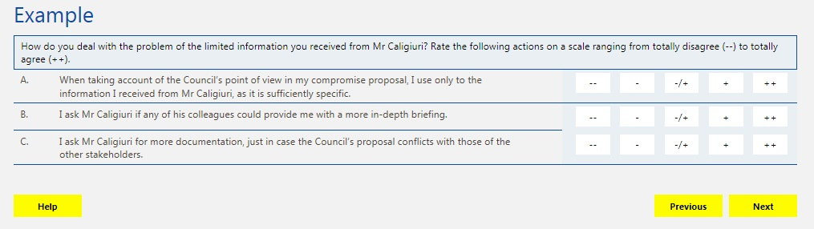
Primjer e-tray zadatka

Slide 36
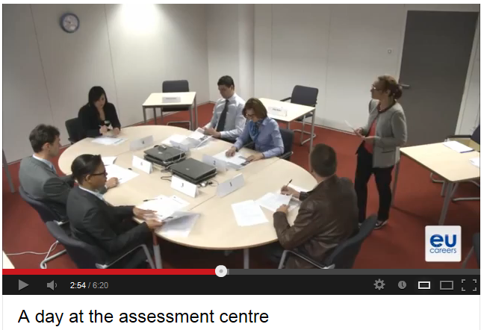
Centar za procjenu
Notes:
http://www.youtube.com/playlist?list=PLNS-NTgNUQ__by8h4h1fgYZQp2wXrfoWz

Slide 37




Dobro je znati!
Kreirajte svoj EPSO račun
na eu-careers.eu PRIJE prijave na natječaj
Ne čekajte zadnji dan da biste napisali i poslali prijavu!
Budite u toku s informacijama o natječajima,
Prijavite se za primanje obavijesti: eu-careers.info
Nakon što ste se prijavili, redovito provjeravajte svoj EPSO račun.
Informacije o napretku postupka primat ćete isključivo putem svojeg računa.
Notes:
You can only apply online. You have to create an EPSO account before you apply or use your existing account if you have one.
Later in the selection procedure, when invited to the Assessment Centre phase you will be asked to provide the official documents of your diploma etc.
Don't wait until the last day to sign up for the competitions! The self-selections tests require time as do filling out the application form.
Don't forget to sign up for updates on the competition on the blog part of eu-careers.eu website: eu-careers.info
Check you account regularly for results, invitation to sit the tests etc. The account is the
You can only apply for a competition during the application period (4 weeks) – but you can create your epso account any time.

Slide 38
Jobs.eu-careers
Drugi selekcijski postupci
Područje | Otvaranje | Zatvaranje
Heads of Administration in EU Delegations based in third countries (AST4) | 09/04/2015 | 12/05/2015
Parliamentary Ushers (SC1) | 23/04/2015 | 26/05/2015
Cooperation and Management of aid to non-member countries (AD7) | 07/05/2015 | 09/06/2015
Lawyer-linguists (AD7) – languages to be confirmed Translators (AD5) – languages to be confirmed | May/June June/July | June July
Notes:
Annual cycles:
Competitions open for graduates without experience
Languages for lawyer-linguists + translators competitions vary annually.

Slide 39
Druge mogućnosti
http://europa.eu/about-eu/working-eu-institutions/index_en.htm
Privremeni djelatnici
Privremeni djelatnici (preko agencija)
Honorarni
djelatnici
Upućeni nacionalni stručnjaci
Stažisti
Ugovorni djelatnici
(CAST)
Notes:
Fixed-term contracts (CAST)
(See also "Temporary contracts")
The EU institutions and agencies employ staff on fixed-term contracts to provide additional capacity in specialised fields where there are not enough permanent officials with the required skills.
Contracts are offered for specific manual or administrative tasks. They are generally limited in duration – often for an initial period of 6-12 months.
Contract staff are recruited from a pool of applicants (kept in a database) following a selection procedure usually organised by the European Personnel Selection Office.
The difference between an open competition and a selection procedure for contract staff (CAST) is that:
- there is no assessment centre stage
- the number of successful candidates is not predefined.
Regular annual selection procedures of contract staff for a limited number of generalist profiles such as secretaries, administrative staff, human resources staff, financial managers, auditors, IT and telecommunications specialists, will be introduced soon.
The majority of positions are based in Brussels and Luxembourg.
European Commission specific rules for employment of contract agents
European Parliament specific rules for employment of contract agents
Overview of selection procedure
There is a two-phased procedure starting with reasoning tests or CV sift (depending upon the profile) followed by a competency test:
for generalist profiles, the first step consists of verbal, numerical and abstract reasoning tests
for specialist profiles the procedure begins with selection based on qualifications (CV sift)
the competency test may be a written, oral or other practical test in the field (for example translating a text).
If successful, your name will generally remain in the database for three years.
You may apply for one generalist profile and one function group per year only.
Temporary contracts
(See also Fixed-term contracts)
Temporary contracts are offered for a wide variety of highly specialised or temporary tasks, for limited durations , for example in the field of scientific research.
Selection and recruitment of temporary staff is generally run by individual EU institutions and agencies. Check regularly for news of current selections and vacancies.
You can also introduce your details into the EU CV online database.
Interim staff (temps: up to 6 months)
Some EU institutions employ local staff through temping agencies on a very short-term basis.
Interim consultants
Some departments employ consultants directly through tendering procedures.
For more information, please consult EU tenders and contracts.
Freelance linguists
To become a freelance translator
for the European Commission, please consult the notices of call for tenders
for the Court of Justice, consult the contract notices.
To become a freelance interpreter at the European Commission, the European Parliament or the European Court of Justice, please see Interpreting for Europe.
Junior Experts in Delegations (JED)
The EU's external service delegations, situated in particular in developing countries, employ university graduates from EU countries as junior experts (full members of the administrative and technical staff) for up to two years. For more information, see the Junior Experts in Delegation programme.
EU experts (database of experts)
Independent experts available to assist an institution or agency in a specific field are invited to create a password-protected profile containing their details (contact details, specialisation, credentials, etc.) in expert databases maintained by individual EU institutions and agencies. They can then be called on for specific tasks as needed.
See, for example:
Community Research and Development Information Service (CORDIS)
European Commission – Humanitarian Aid & Civil protection
Seconded national experts
National and international civil servants and public sector staff are invited to bring their experience to the EU institutions for a few years, and to take back to their home administration and knowledge of EU policies and procedures gained during their secondment.
National experts are selected through a specific procedure. Please contact your country's permanent representation to the EU for information about current opportunities.
Maintenance and canteen staff
Certain categories of staff such as maintenance workers and canteen staff are recruited via external contracting companies. These contracts are awarded through open tender procedures.
Check the contracting services for more information.
Top

Slide 40
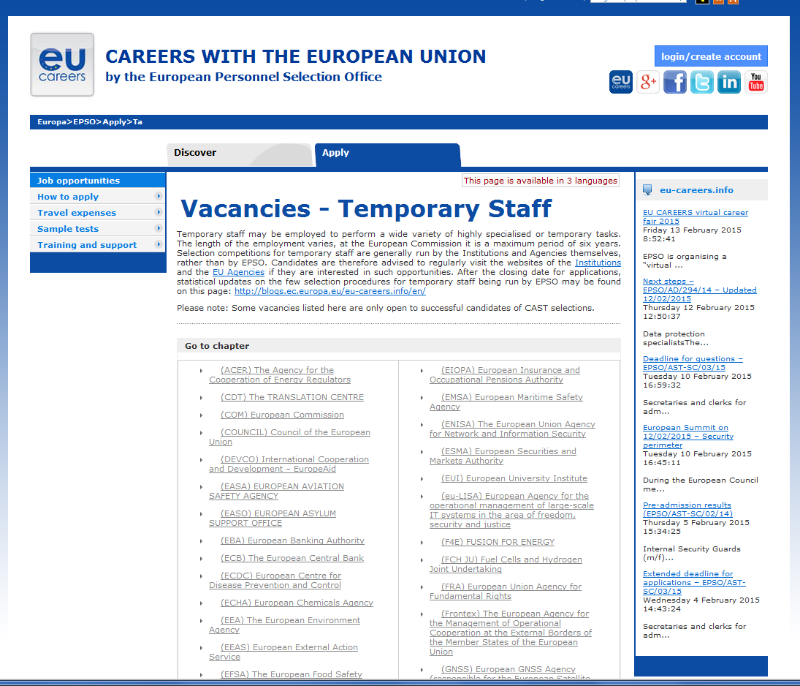
Jobs.eu-careers.eu

Slide 41

Stažiranje
(pripravništvo)
Notes:
EU knowledge & insight into the processes and policies of the European Institutions,
practical experience – an opportunity to play a part in the Commission's day-to-day business (same as low lever admisinstrator)
Not a boring internship - attending and organising meetings, working groups, forums, public hearings,
researching and compiling documentation, reports, consultations; answering queries,
running projects.

Slide 42
Stažiranja
EU institucije & agencije
5
mjeseci*
Brussels,
Luxembourg i
drugdje
Stjecanje iskustva
Praktičan svakodnevni rad
Vrlo konkurentan natječaj
Plaćeno!
Notes:
EU knowledge & insight into the processes and policies of the European Institutions,
practical experience – an opportunity to play a part in the Commission's day-to-day business (same as low lever admisinstrator)
Not a boring internship - attending and organising meetings, working groups, forums, public hearings,
researching and compiling documentation, reports, consultations; answering queries,
running projects.
Highly competitive procedure

Slide 43
Gdje?
Notes:
See link in our website:……. There are also traineeships in the EU Agencies, you will have to do some research yourself.
There is handy leaflet with all traineeships on it on our website
Institution – Duration - Paid?- Application deadlines - Start dates
European Commission
5 months
Yes, around 1100€
31 January 31 August
1 October 1 March
European Parliament
5 months
Up to 3 months (unpaid)
Yes, around 1200€
No
15 May 15 October
At least 3 months before start date
1 October 1 March
1 January 1 May 1 September
European Council
5 months
Mostly
31 August in the year before the traineeship
1 February 1 September
Court of Justice
5 months
Yes
1 October 1 May
1 March 1 October
Court of Auditors
5 months
Usually around 1100€
On-going
Variable
Economic and Social Committee
5 months
Yes
30 September 31 March
16 February 16 September
Committee of the Regions
5 months
Yes, around 1000€
30 September 31 March
16 February 16 September
European Ombudsman
4-12 months
Yes, pay decided on a case-by-case basis
30 April 31 August
1 September 1 January
European Central Bank
Variable
Yes, 950€ or 1800€, dependent on duties
Not fixed, posted on website
Variable
European Data Protection Supervisor
5 months
Yes, 950€
1 October 1 March
1 March 1 October

Slide 44

Tko se može prijaviti?
Prvostupnička diploma
2
EU jezika
Jedan od njih je
NE morate biti državljanin EU
NEMA
dobne granice
NE
smije se imati ranijeg radnog iskustva u EU institucijama
Ti?
Notes:
EU knowledge & insight into the processes and policies of the European Institutions,
practical experience – an opportunity to play a part in the Commission's day-to-day business (same as low lever admisinstrator)
Not a boring internship - attending and organising meetings, working groups, forums, public hearings,
researching and compiling documentation, reports, consultations; answering queries,
running projects.

Slide 45
Kako i gdje se prijaviti?
Pregled
Pred-selekcija
Prvojera udovolja-vanja kriterijima
Online
prijava
6 mjeseci unaprijed
Selekcija
Za stažiranje od:
1. listopada – prijave u siječnju
ožujka- prijave u srpnju/kolovozu
uvjeti prijave mogu odstupati ovisno o instituciji
niz drugih opcija
Notes:
Some figures
10.000 to 18.000 applicants
2.000 preselected for the so called 'blue book
600 approx. receive an offer
Online application for EC Traineeship:
http://ec.europa.eu/stages/index_en.htm

Slide 46


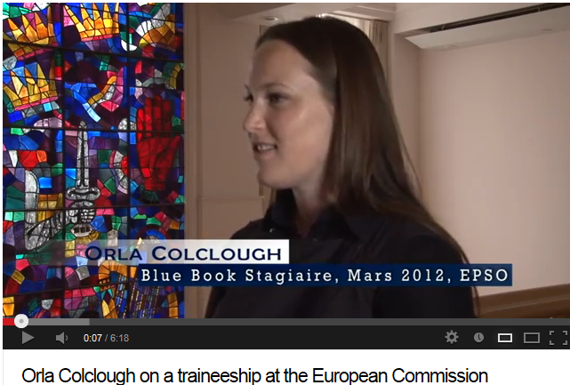

Stažiranje
Europska komisija
http://ec-traineeship.findtalk.biz/
Notes:
http://www.youtube.com/watch?v=y7TNX8AU3qU
http://www.youtube.com/watch?v=kC4vN-ebKZU -
some blogs people read:
http://ec-traineeship.findtalk.biz/
http://www.atraineeinbrussels.com/ (light-hearted…)
– the same is going on @FB: https://www.facebook.com/ATraineeInBrussels

Slide 47

Kako i gdje se prijaviti?
Europska komisija
http://ec.europa.eu/stages/

Slide 48
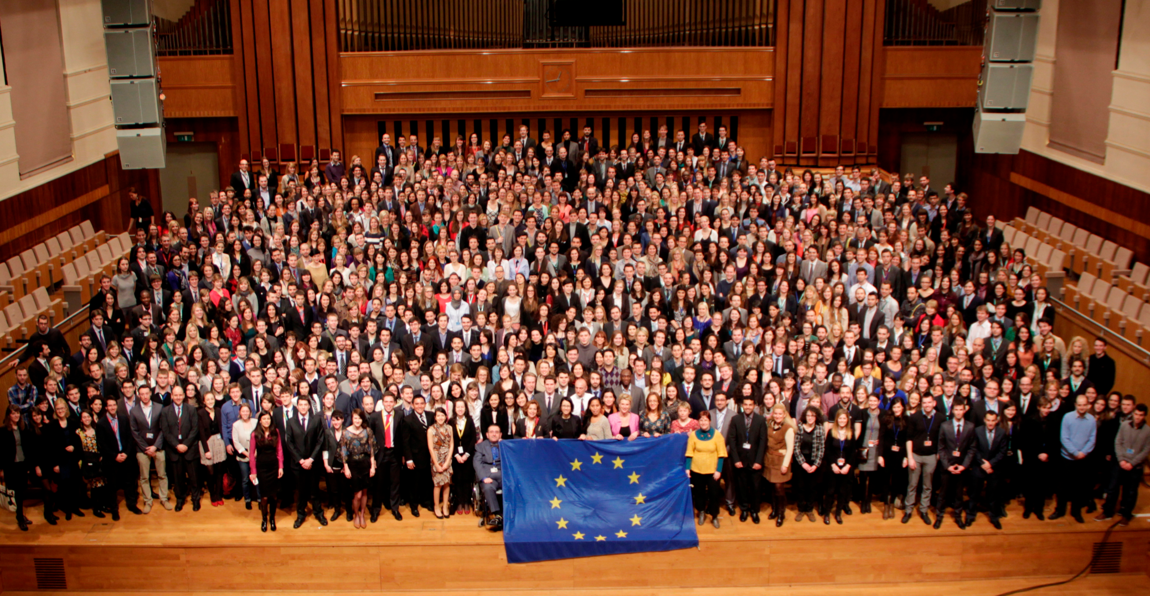

Slide 49


www.eu-careers.eu
Notes:
You will find more information and the latest news regarding competitions on the EU Careers website. The Discover EU careers section has information in 23 languages, the other two sections are in English, French and German.
For full overview of upcoming selection procedures visit our website - http://europa.eu/epso/doc/epso_planning_en.pdf
On our facebook page… you can find…also our raconteurs, blogging about their work at the EU institutions. Contextual information - (photo's, videos)
Computer Based Tests (CBT)
http://europa.eu/epso/discover/prepa_test/sample_test/index_en.htm
Does your country provide support for your potential EU Career?
http://europa.eu/epso/discover/prepa_test/disclamer/preparatory_en.htm
Variety of Traineeships (also languages, sciences) : http://ec.europa.eu/stages/index_en.htm
Temporary Vacancies: http://europa.eu/epso/apply/today/temporary_en.htm
Other: http://europa.eu/youreurope/citizens/work/job-search/index_en.htm

